Slide 1


CS
VEHICLE REPAIR HUB
ENHANCING UX IN VEHICLE MAINTENANCE AND REPAIR

Slide 2

OUR TEAM
AAGHASH M
CHANDRU K T
LAKSHIN S
SRIVATHSAN K

Slide 3
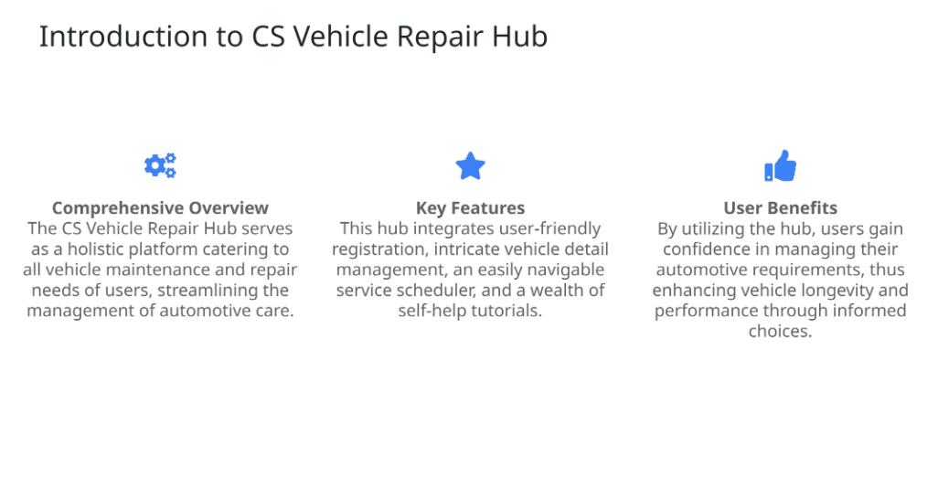
OVERVIEW

Slide 4
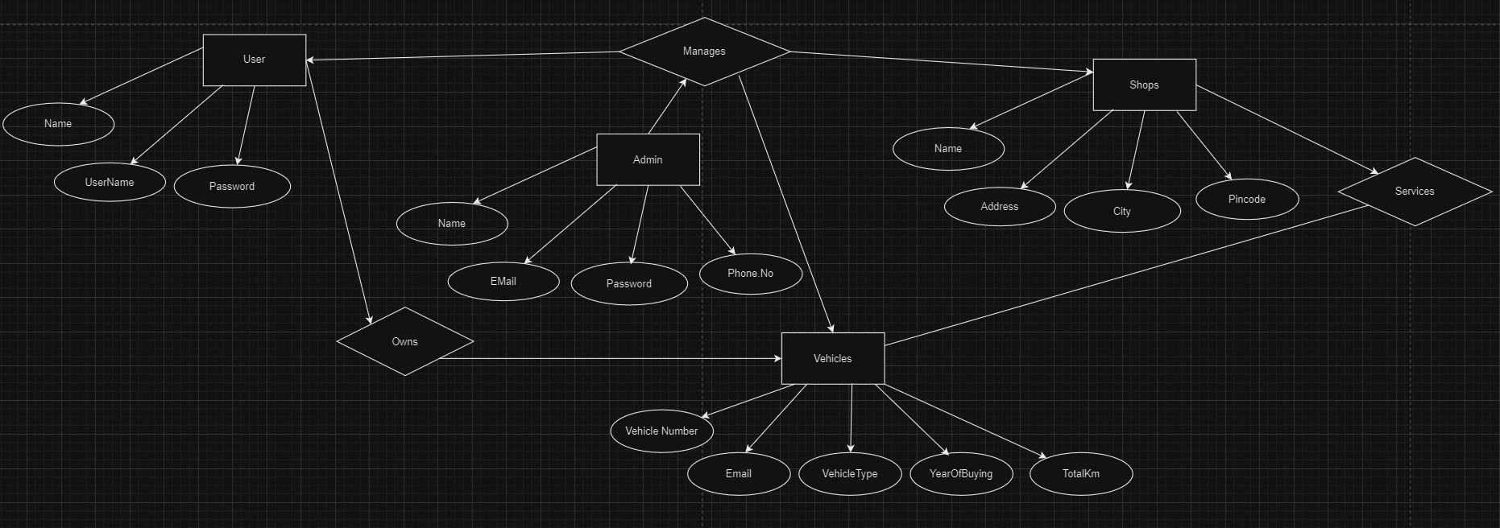
ER DIAGRAM

Slide 5

TECH STACK
• Modern Frontend Technologies: The use of React and CSS enables the development of a responsive,modern user interface that enhances the user experience significantly.
• Powerful Backend Infrastructure: Spring Boot serves
as the backbone, managing server-side processing and
business logic effectively, ensuring robustness and
performance.
• Reliable Data Management: MySQL provides a reliable
and efficient database solution for storing user
information, vehicle data, and service records.
• YouTube API Integration: Integration of YouTube's API
facilitates seamless access to video tutorials, enriching
the user experience with multimedia resources.

Slide 6
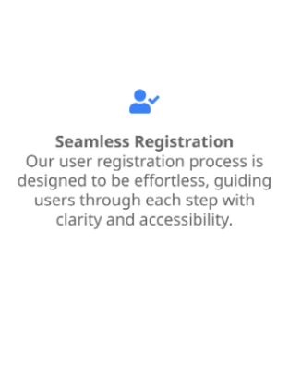
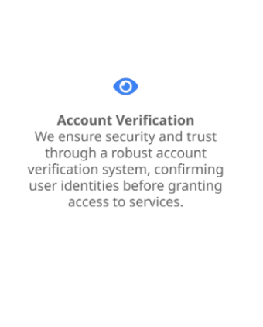
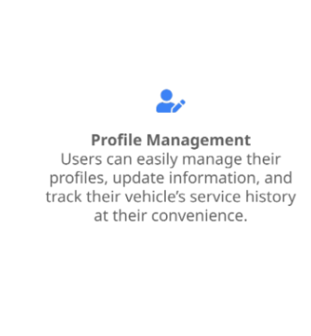
USER REGISTRATION

Slide 7
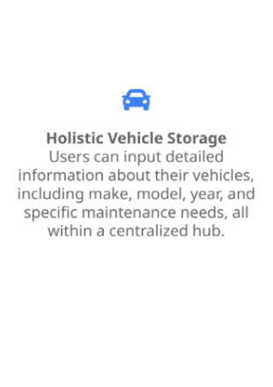
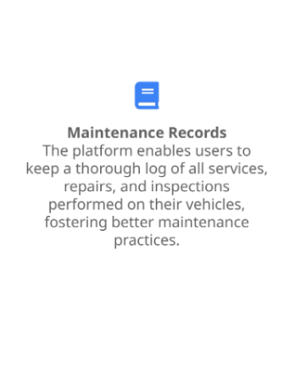
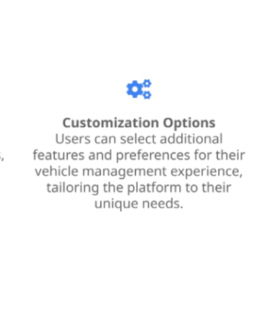
VEHICLE DETAILS MANAGEMENT

Slide 8
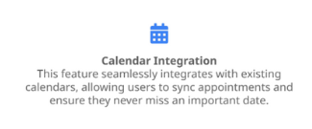
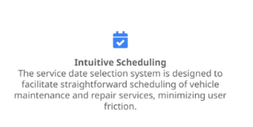
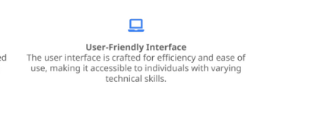
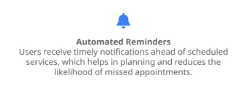
SERVICE BOOKING

Slide 9
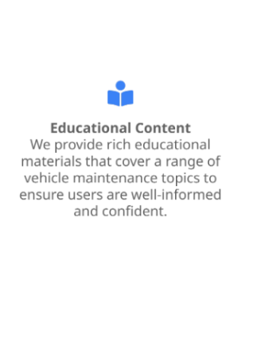
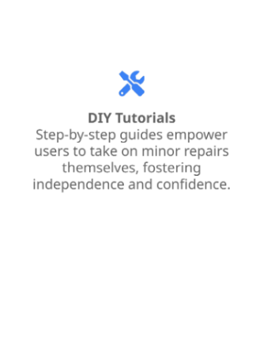
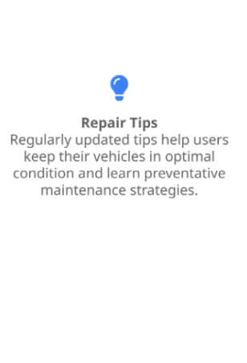
INFORMATIVE GUIDES

Slide 10
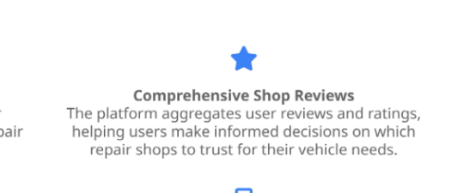
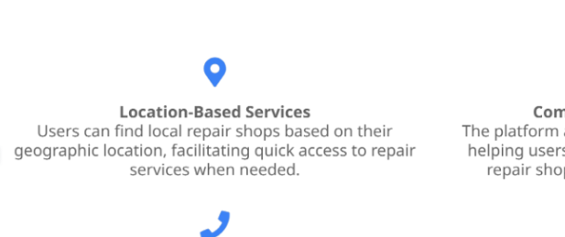
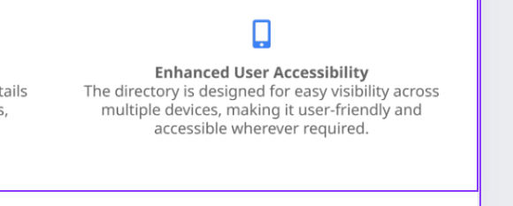
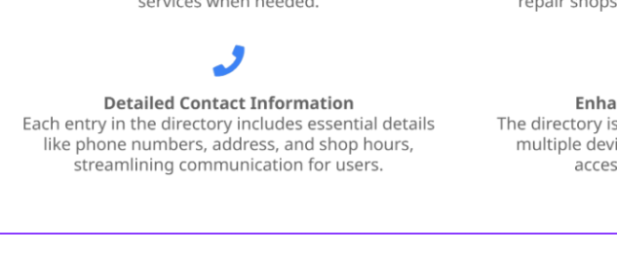
DIRECTORY OF SHOPS

Slide 11

EMPOWERING WITH TIPS
• Essential Maintenance Tips: Regular maintenance
tips provided help users uphold vehicle health,
potentially preventing costly repairs in the long run.
• Actionable Troubleshooting Guides: Users gain
access to troubleshooting guides that enable them
to quickly address minor vehicle problems with
confidence.
• Proactive Prevention Strategies: Advice centered
on proactive measures, such as regular check-ups
and monitoring fluid levels, empowers users to
manage their vehicles effectively.
• Building User Confidence: By equipping users with
knowledge. the platform fosters confidence in
handling their vehicle's maintenance issues
independently.

Slide 12


ADMIN DASHBOARD
• User Management Features: The admin
dashboard provides robust tools for managing
user data, permissions, and settings, ensuring
optimal platform operation.
• Role Permissions Administration: Flexibility to
assign specific roles and permissions enhances
the security and organization of operations on
the platform.
• Data Analysis and Insights: The dashboard
allows for tracking user interactions and system
performance, facilitating data.driven decision.
making for service improvements.

Slide 13

THANK YOU

